Slide 1
RCT Recruitment Website Recs

Slide 2
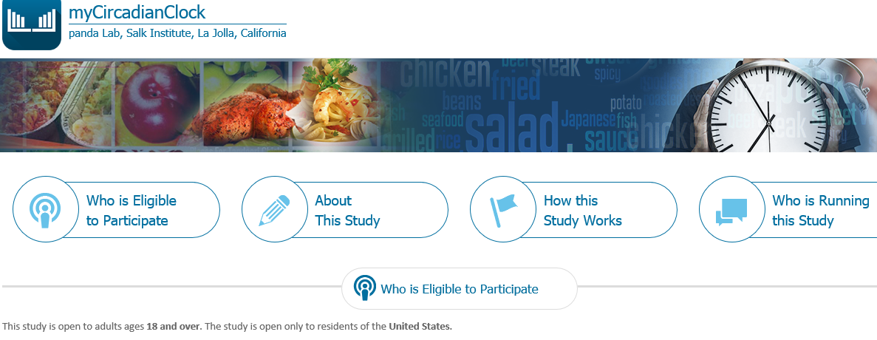
For now retitle “myWeightLoss”
San Diego County residents age 21-55 who are obese (BMI >30)

Slide 3
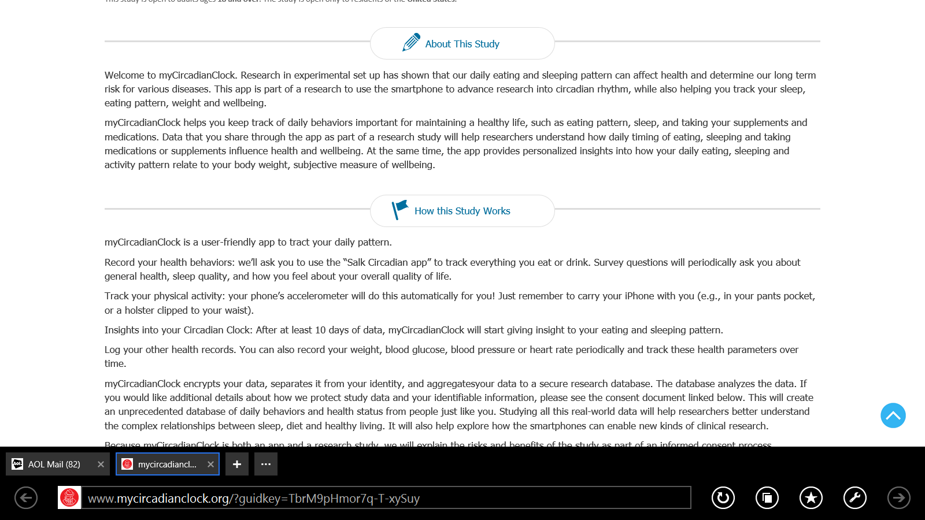
Welcome to our study!
Research has shown that our daily eating and sleeping pattern can affect health and weight loss. We are interested in exploring if logging what you eat via your smartphone’s camera can improve health measures like weight loss. We are also curious to know if eating in a self-selected 10-hour window would assist in weight loss.

Slide 4
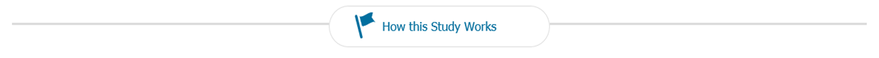
Or: What is required of you
To determine if you are healthy enough to participate a screening process is required. The screening and study participation includes:
Measuring height, weight and body composition
Completing a series of questionnaires and food recalls
Four (4) blood draws will be completed for laboratory tests (over 1 year).
You will be asked to download an app from the App Store. Using this app, you will take pictures of everything you eat or drink for the duration of 2 weeks.
Wearing a watch like device on your wrist day and night that will record your physical, sleep, and how much light you get.
If you pass the screening you will be randomized assigned to one of two groups for 12 weeks:
1. Healthy Habits group – where you will receive and partake in a 30-minute group class discussing the handouts.
2. Time Restricted Feeding group – where you will instructed to continue using the app and select a 10 hour eating window for 12 weeks
After 12 weeks the body measurements, questionnaires and blood draw will be repeated.
At 6 and 12 months you will be contacted to come in for follow-ups requesting you to complete questionnaires, have the body measurement measured and blood for the same tests.

Slide 5
Insert header saying: How your participation assists us – OR SOMETHING
Your participation in this study helps us study to assess the effect healthy habits and app-assisted time restricted eating has on weight loss and other health factors.

Slide 6
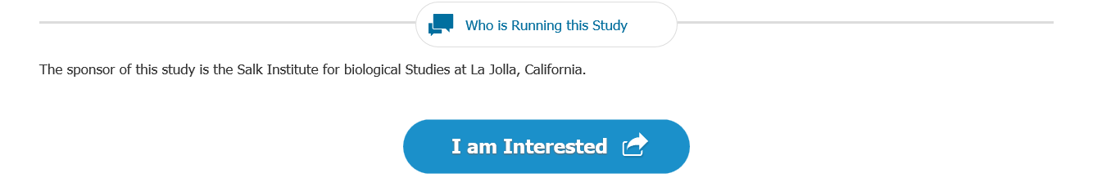
Who is Sponsoring this Study – [not who is running….]
I am ready to do this! - Tell me More - Am I Eligible *
*Last 3 just different options for target audiences. I can come up with lots, so let me know if you want more.

Slide 7
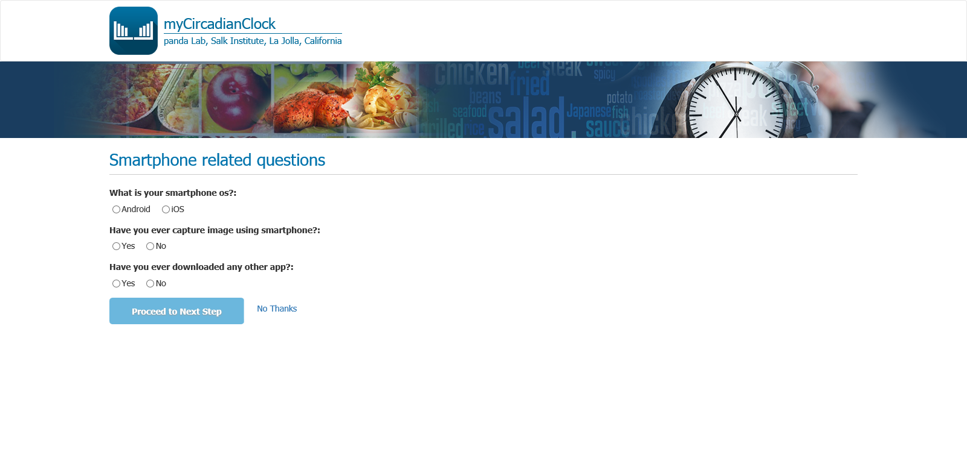
How well do you know your phone?

Slide 8
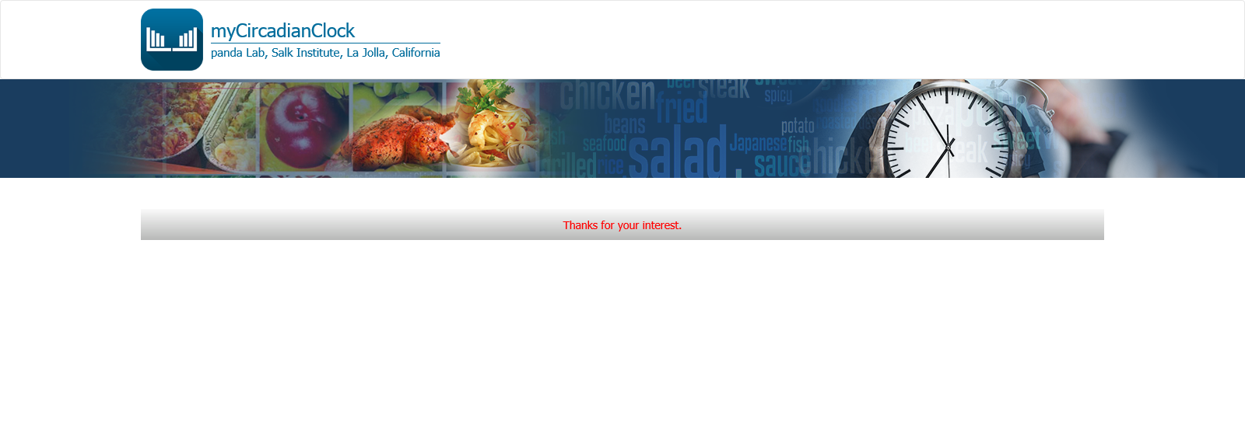
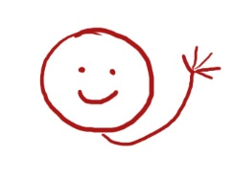
Thank you for your interest .
Thank you for your interest!

Slide 9
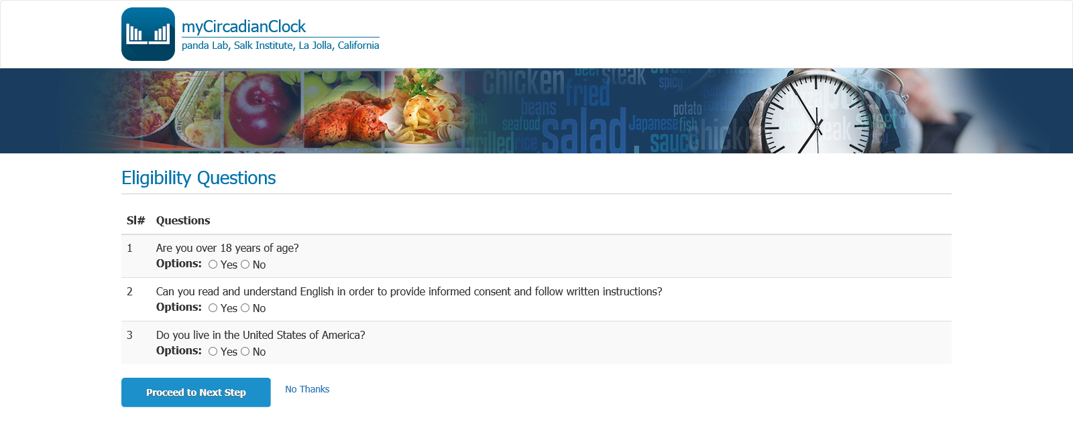
BMI ≥30 kg/M2. Put a sentence about BMI here.
You may have a BMI calculator here.
Age of 21-55 years
Agree to 3 blood draws over course of study
Weight stable over last 6 months
Own an iOS or Android device capable of running the app
Able to understand and comprehend consent and adherence to recording daily nutrient consumption
Willing and able to wear a watch-like device for at least 2 weeks at a time.

Slide 10
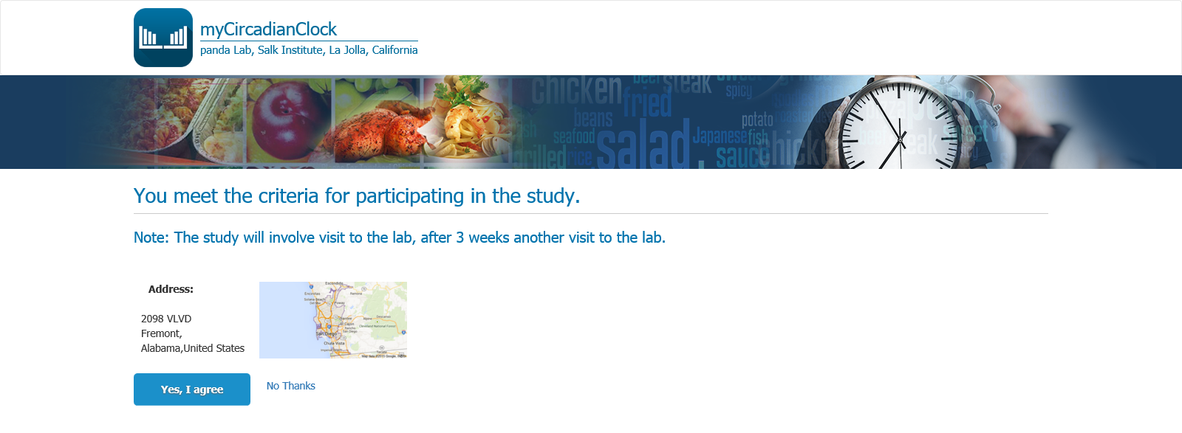
Congratulations! You meet the study criteria for participation.
Please enter your Name___________, email:________, phone number ___________
Then click the button below to inform study personnel that you are ready to be contacted for further information!

Slide 11
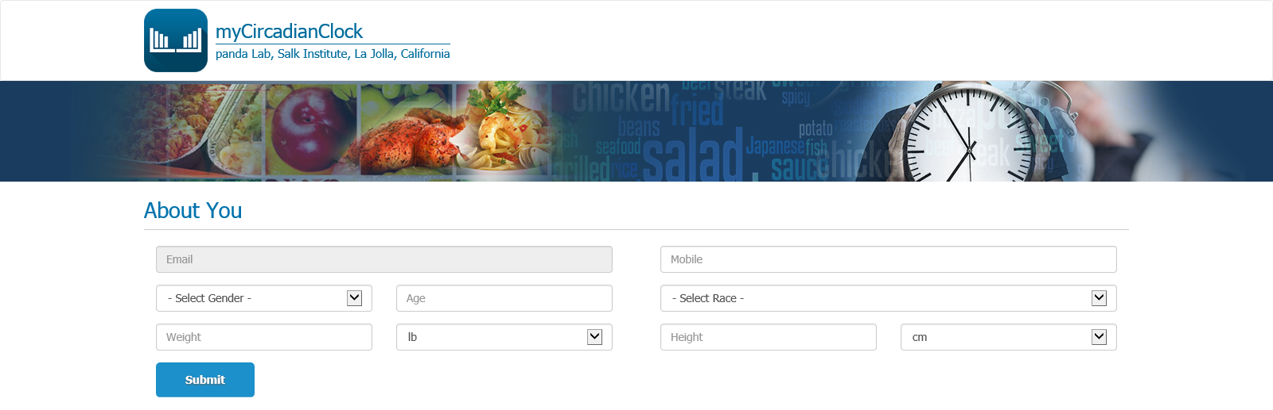
Delete page because all information will have to be hand entered into system from screening.

